Slide 1


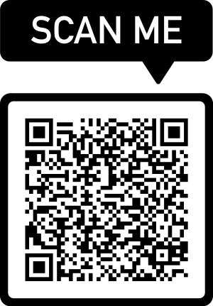
JULEFROKOST 2022
SPOTIFY
COLLABORATIVE PLAYLIST
MONDAY 12 DECEMBER 13.30 HRS
MOVIE TICKET
ADMIT ONE
IF YOU DON’T HAVE SPOTIFY, JUST SEND ME AN EMAIL WITH YOUR REQUEST!
anfig@dtu.dk

